Slide 1
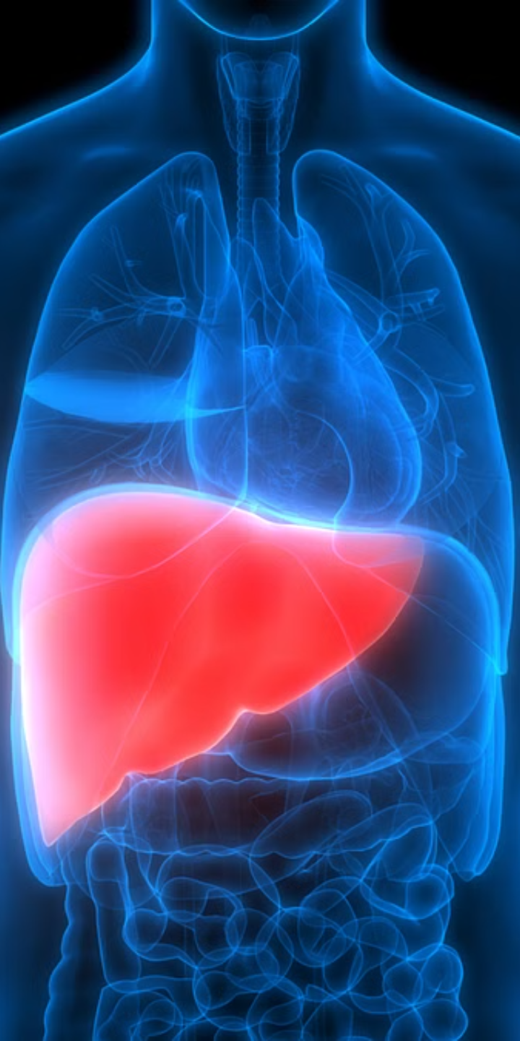
Liver Tumor Segmentation using Deep Learning
This study uses deep learning to improve the accuracy of liver tumor segmentation in CT scans. We compared U-Net and ResNet-50 architectures using 200 anonymized CT scans with expert annotations.
Our methodology included data augmentation and stratified k-fold cross-validation. Results showed U-Net outperforming ResNet-50, as measured by Dice similarity coefficient and Intersection over Union. Limitations and future directions are discussed.
by Shantanu Roy (roy33), Eranki Vasistha (veranki2),
Shreyas Kulkarni (ssk16)

Slide 2
Table of Contents
Project Motivation
1
The need for precision in liver tumor segmentation
2
Datasets Used
Overview of the data used in the study
Experimental Setup & Methodology
3
Detailed description of our approach
4
Model Architectures
U-Net vs. ResNet-50
Evaluation Metrics
5
Metrics used to assess model performance
6
Results
U-Net outperforms ResNet-50
Conclusion
7
Summary of findings and implications
8
Limitations & Future Directions
Areas for improvement and future work
Key Takeaways
9
Main points of the study

Slide 3
Project Motivation: The Need for Precision in Liver Tumor Segmentation
Improved Diagnostic Accuracy
Enhanced Treatment Planning and Efficacy
Precise liver tumor segmentation is crucial for accurate diagnosis and treatment. Deep learning improves segmentation accuracy, enhancing diagnostic confidence.
Accurate segmentation is vital for effective treatment planning. This improves surgical precision and radiation therapy, minimizing damage to healthy tissue.

Slide 4
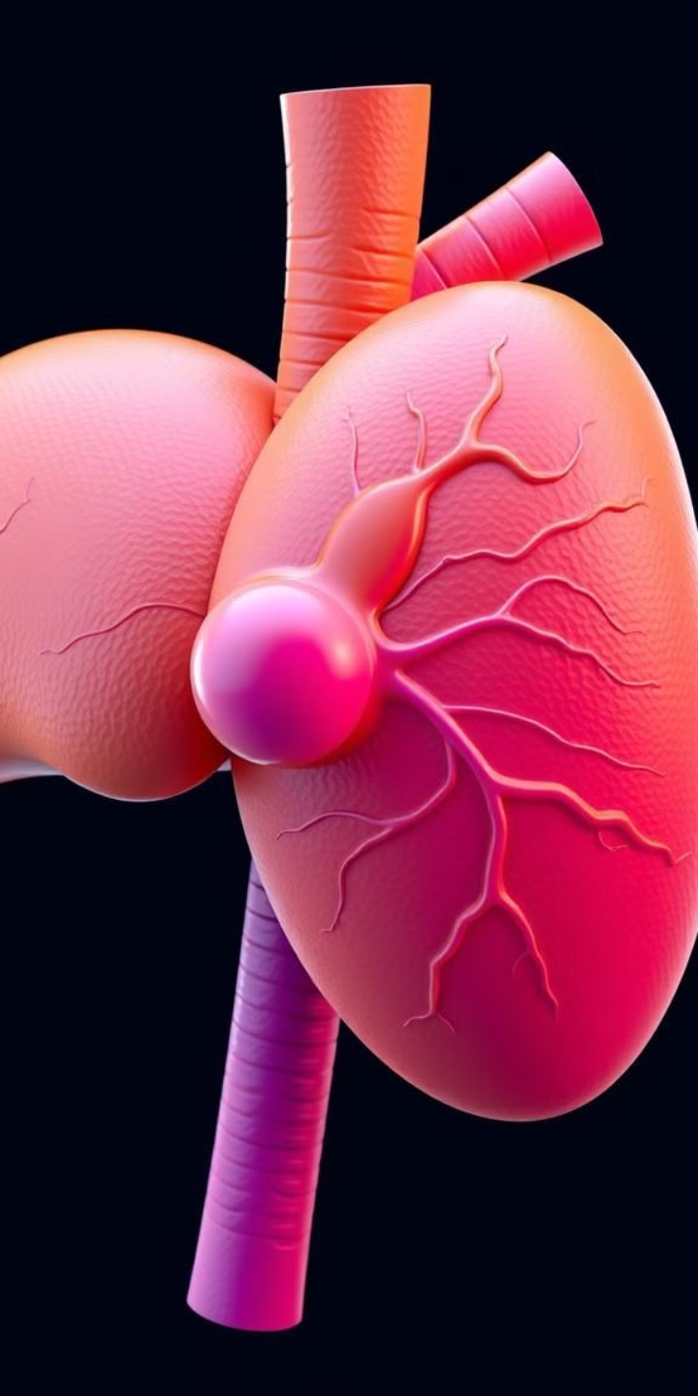
Datasets Used
Liver Tumor Segmentation Dataset (Kaggle)
The Kaggle dataset contains around 200 anonymized 512x512 pixel CT liver scans with expert-validated ground truth masks. These ensure high accuracy and diverse tumor representation.
Link to the dataset :
Part 1 : https://www.kaggle.com/datasets/andrewmvd/liver-tumor-segmentation
Part 2 : https://www.kaggle.com/datasets/andrewmvd/liver-tumor-segmentation-part-2

Slide 5
Experimental Setup and Methodology
Data Preprocessing
Model Training
The Liver Tumor Segmentation dataset was preprocessed using intensity windowing to enhance contrast, histogram scaling for intensity normalization, and multi-channel conversion for feature richness.
U-Net and ResNet-50 (with transfer learning) were trained using TensorFlow/Keras and the Adam optimizer. Data augmentation (rotations, flips, intensity adjustments) and early stopping (based on validation loss) were employed for 100 epochs.

Slide 6
Model Architectures
U-Net
ResNet-50
The U-Net architecture, known for its success in medical image segmentation, was implemented in TensorFlow/Keras. Its encoder-decoder structure with skip connections combined detailed tumor boundaries and broader liver context for precise segmentation within the 512x512 pixel slices.
ResNet-50, a pre-trained model (ImageNet), used transfer learning for liver tumor segmentation. Fine-tuning convolutional layers, followed by upsampling and convolutional layers, generated pixel-wise segmentation maps. Training used a smaller batch size (4) and lower learning rate (1e-5).

Slide 7
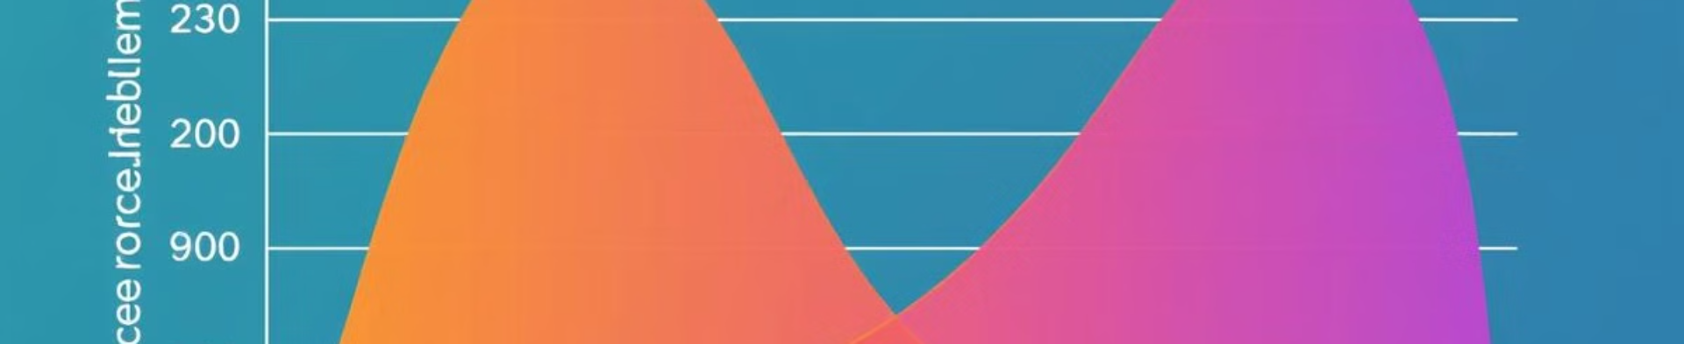
Evaluation Metrics
Dice Coefficient
Intersection over Union (IoU)
This metric measures the overlap between the predicted segmentation mask and the ground truth mask, providing a comprehensive assessment of segmentation accuracy.
The IoU, also known as the Jaccard Index, represents the ratio of the intersection to the union of the predicted and ground truth segmentation areas, offering a robust evaluation of spatial accuracy.

Slide 8
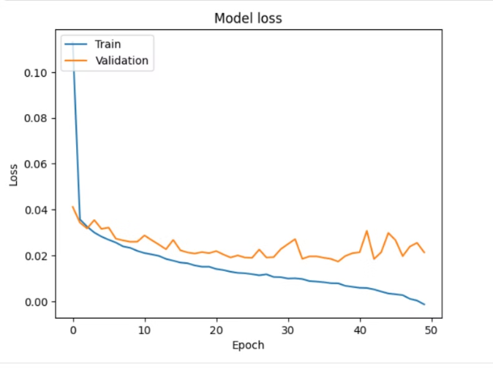
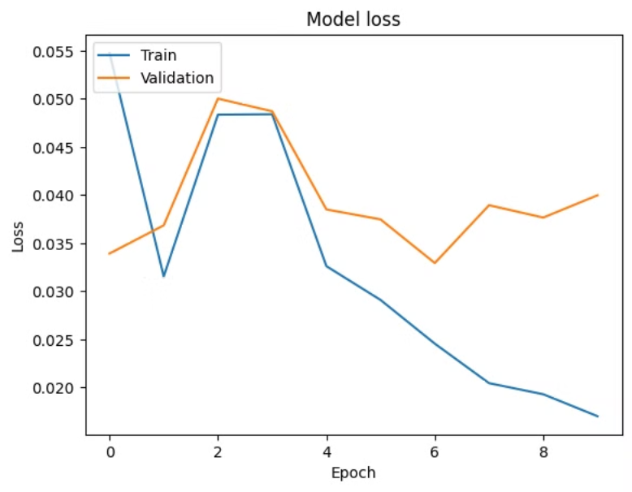
Results: U-Net Outperforms ResNet-50
Figure 1 : Graph of Model Loss v/s Epoch for UNet after
50 Epochs
Figure 2 : Graph of Model Loss v/s Epoch for ResNet-50 after
10 Epochs

Slide 9
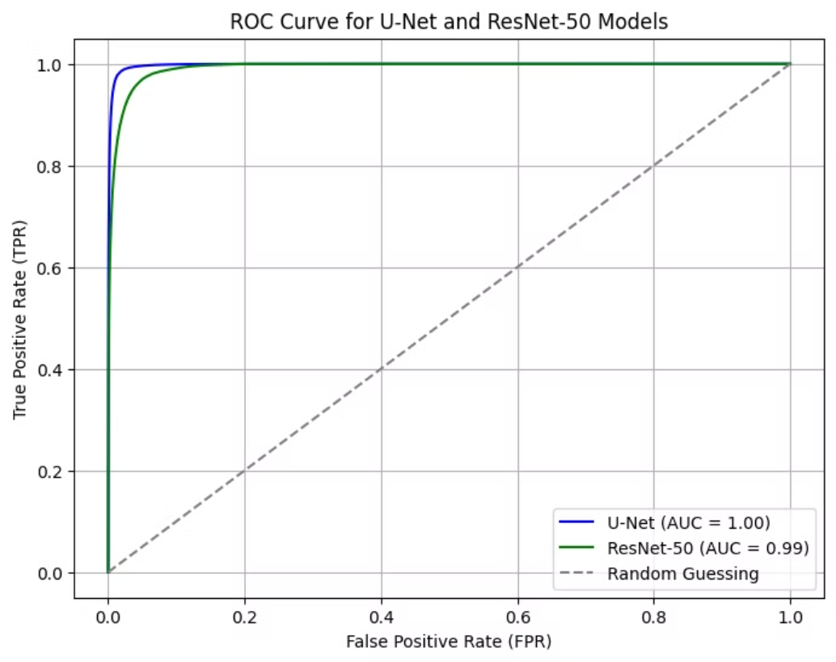
Results: U-Net Outperforms ResNet-50
Figure 3 : Combined ROC Curve for U-Net and ResNet-50

Slide 10
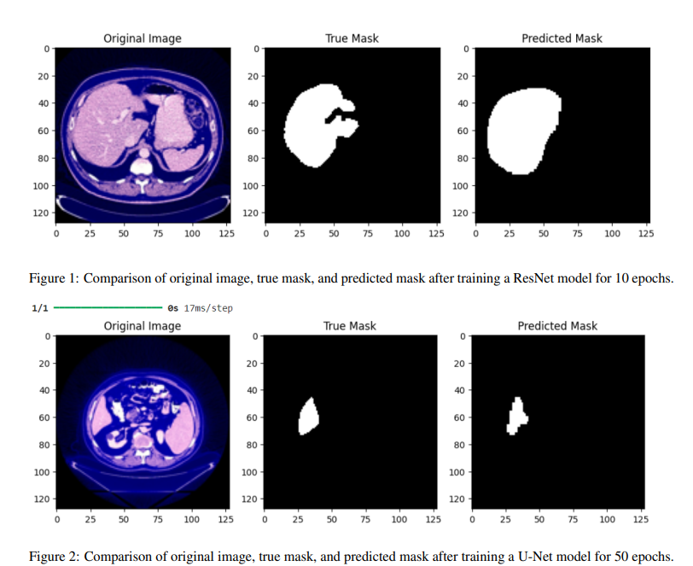
Results: U-Net Outperforms ResNet-50

Slide 11
Conclusion
U-Net's Superiority
U-Net significantly outperformed ResNet-50 in liver tumor segmentation, achieving a Dice coefficient of 0.821 and an AUC of 1.00, compared to ResNet-50's 0.7711 and 0.99. This demonstrates U-Net's superior boundary delineation.
1
Clinical Applications
2
U-Net's high accuracy (Dice: 0.821, IoU: 0.7918) offers significant clinical potential. Automated segmentation can expedite diagnosis, improve surgical planning, and enhance patient outcomes.

Slide 12

Limitations and Future Directions
Dataset Size
Model Optimization
The limited dataset (150 CT scans) may hinder generalization. Future work requires a larger, more diverse dataset for improved robustness.
Further optimization is possible using advanced hyperparameter tuning (Bayesian optimization, genetic algorithms) and exploring alternative loss functions (e.g., focal loss).
Multimodal Data
Integrating MRI and ultrasound data with CT scans could improve boundary delineation accuracy and model robustness.

Slide 13



Key Takeaways
U-Net's Superior Performance
Future Directions: Enhanced Accuracy and Generalizability
Our results demonstrate that the U-Net architecture significantly outperforms ResNet-50 in liver tumor segmentation, achieving a Dice coefficient of 0.821 and an IoU of 0.7918 on a dataset of 150 3D CT scans.
Future work will focus on expanding the dataset, optimizing hyperparameters (including exploring focal loss), and integrating multimodal data (MRI, ultrasound) to improve robustness and accuracy, addressing the limitations of our current model and paving the way for clinical translation.

